Slide 1
1

Slide 2
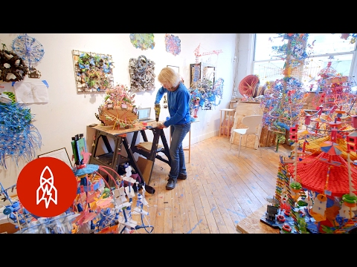
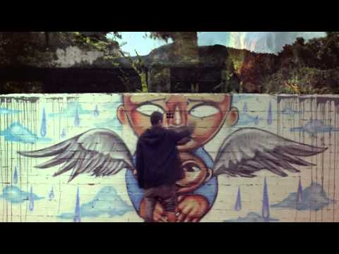
http://roberthodgin.com/portfolio/work/murmuration/

Slide 3


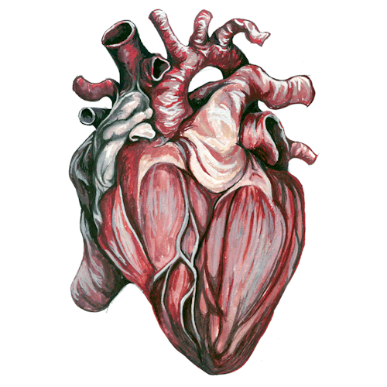
A symbol of the song is the heart beating throughout, which is why I would want to place it in the center.
As time passes, leaves and branches would begin to come out from the heart and spread around to represent weather patterns in Latin American countries.
Other elements that relate to weather such as clouds would also begin to appear.

Slide 4
2

Slide 5
Dementia
Memory
Games
Music
Relatives
Events
Other

Slide 6

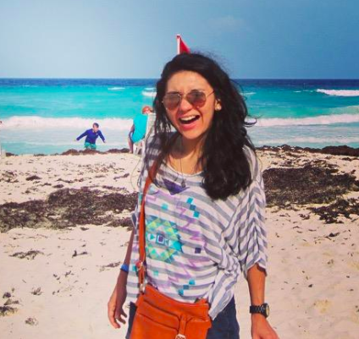

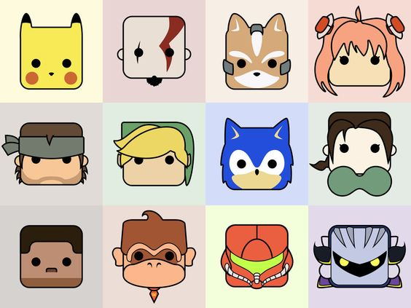


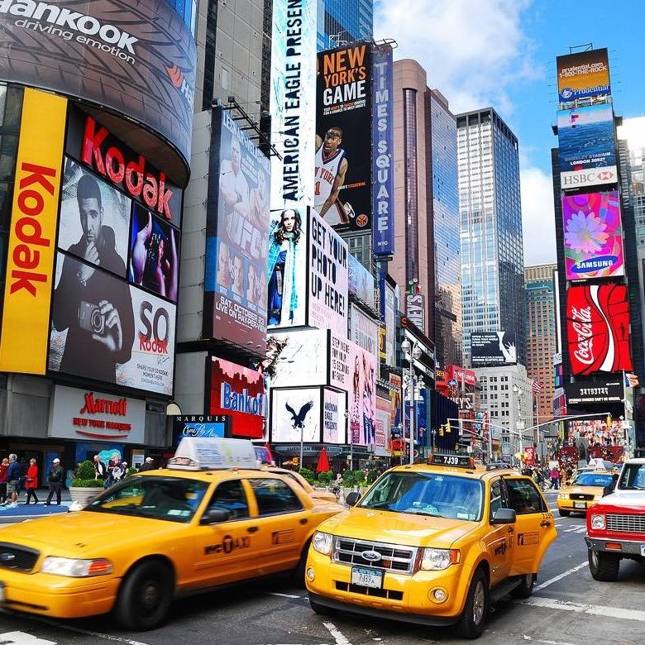

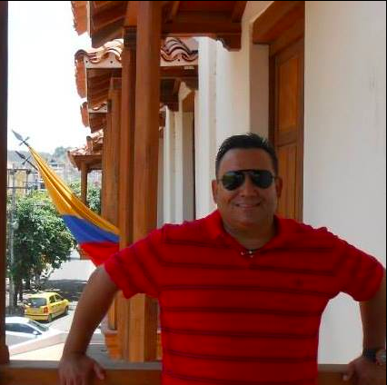
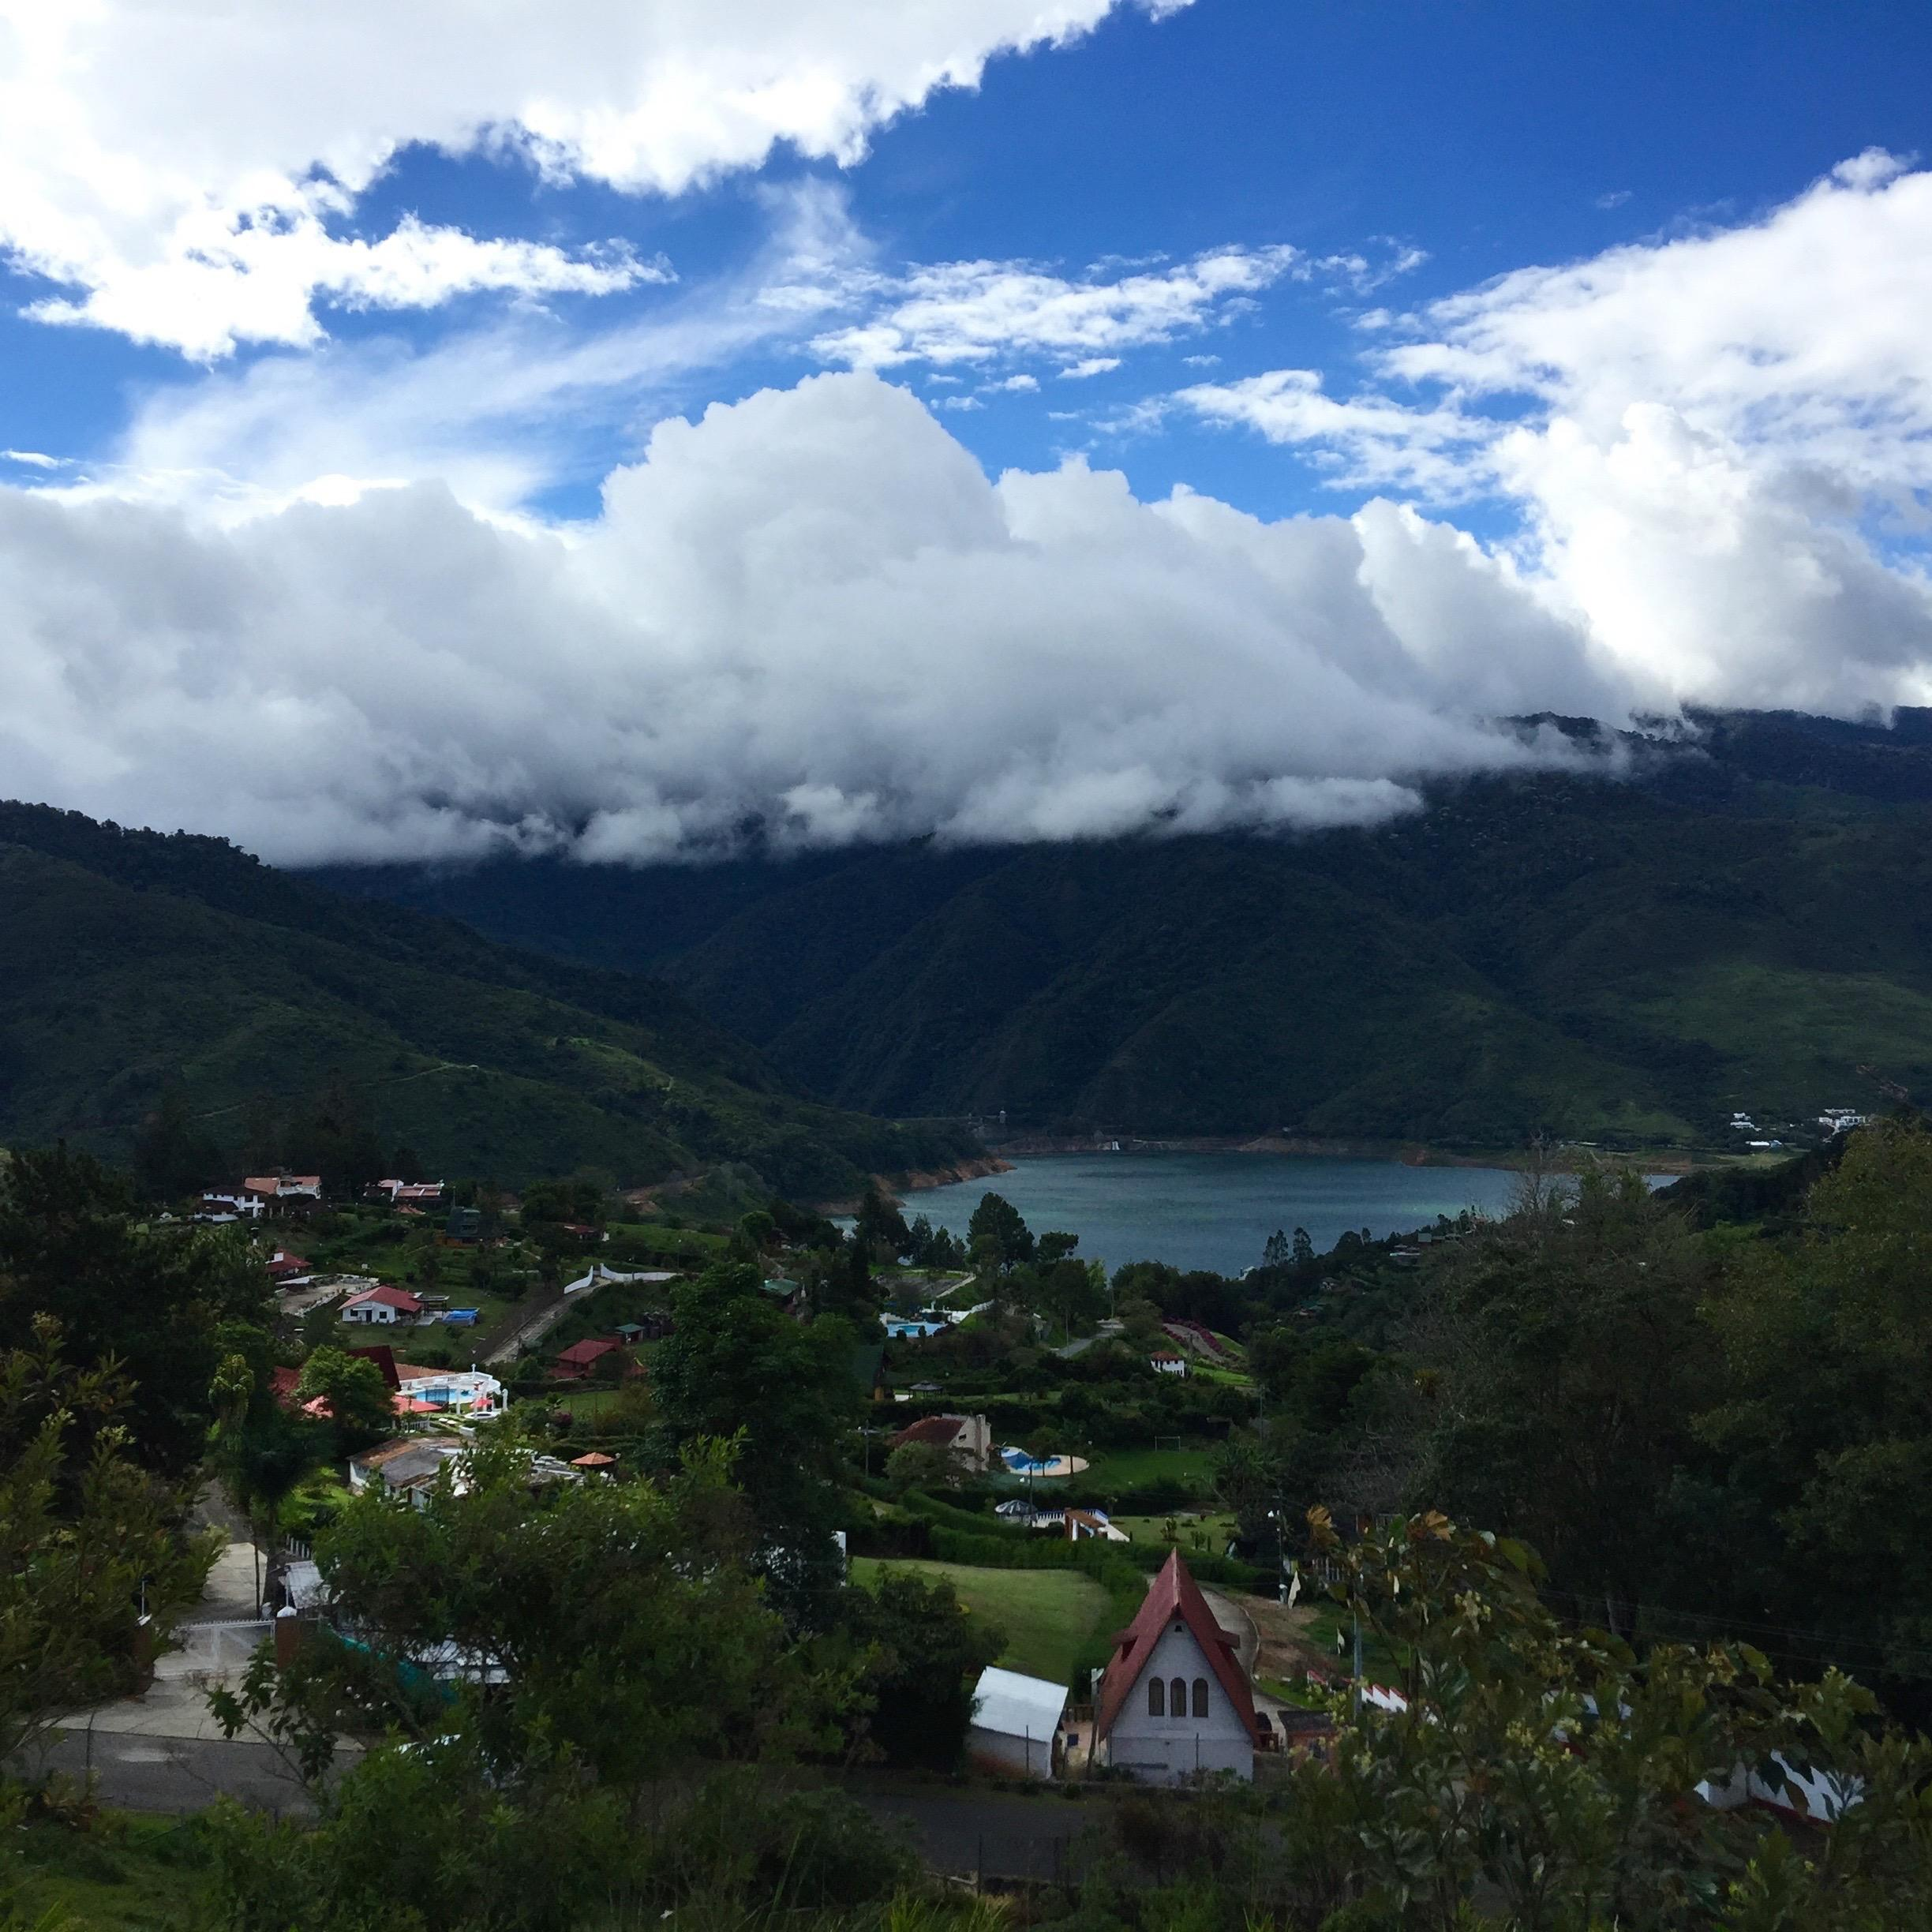
GOAL: Put to test memory of people and some of their information through memory and coordination games.
INTERACTIVITY: Use mouse and other keys.
Pick a Player
What is their name?
Where do they live? Match the location
(For this section I would want about 5 names to float around and she would have to click on the right one in under 15 seconds).

Slide 7
3

Slide 8
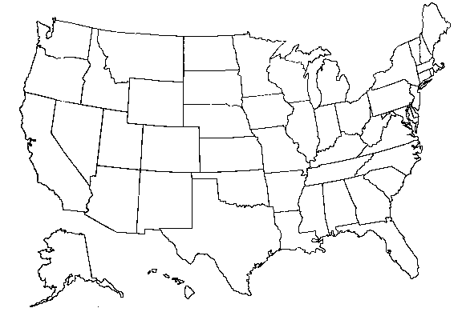








Slide 9
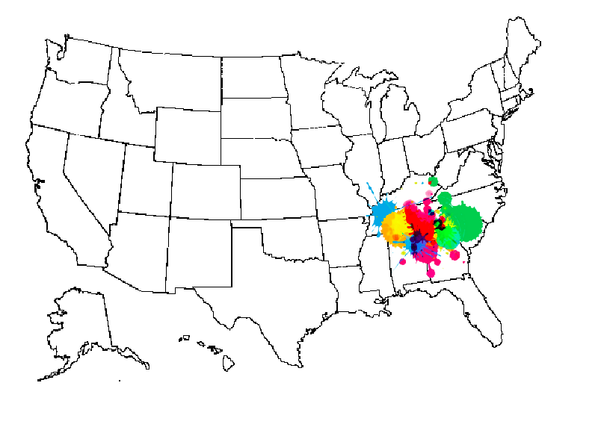
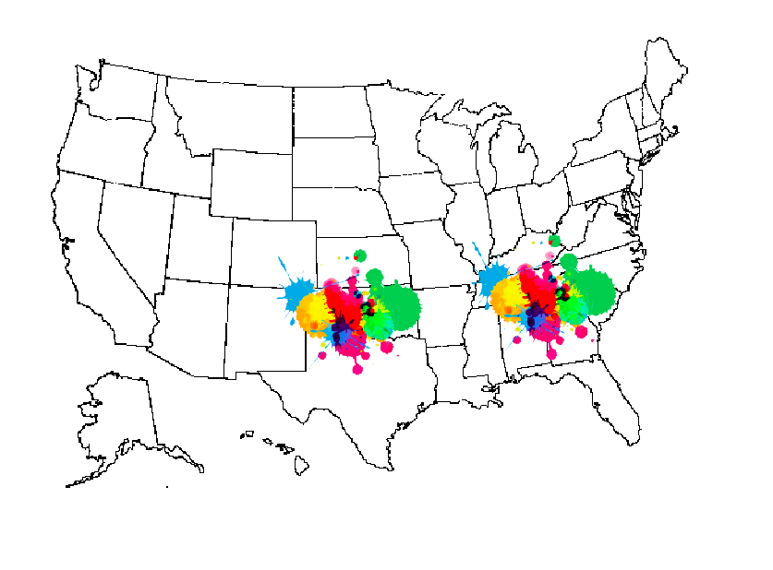
GOAL: Cover country in color
INTERACTIVITY: Control the speed of the balls with a key.
VS

Slide 10
4

Slide 11
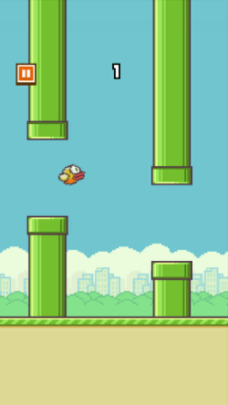
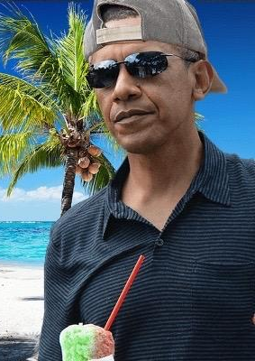
Get Obama back to the White House

Slide 12


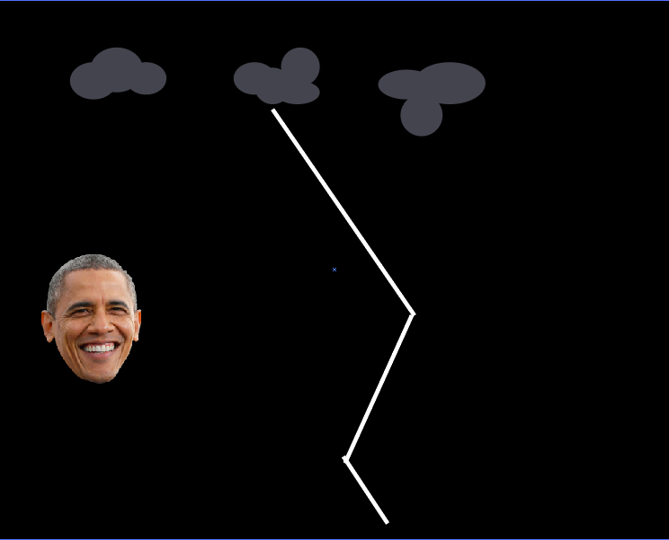
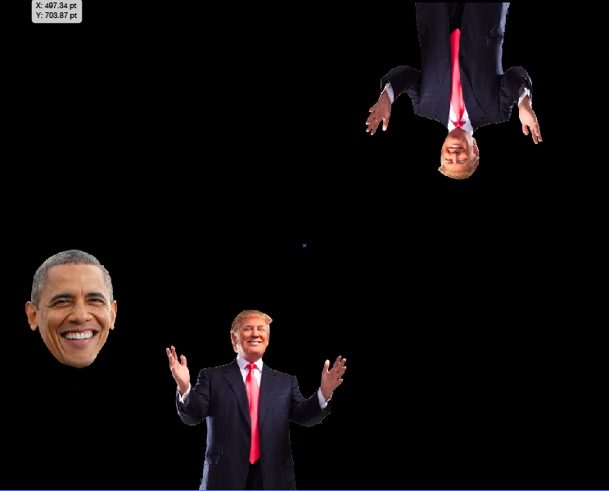
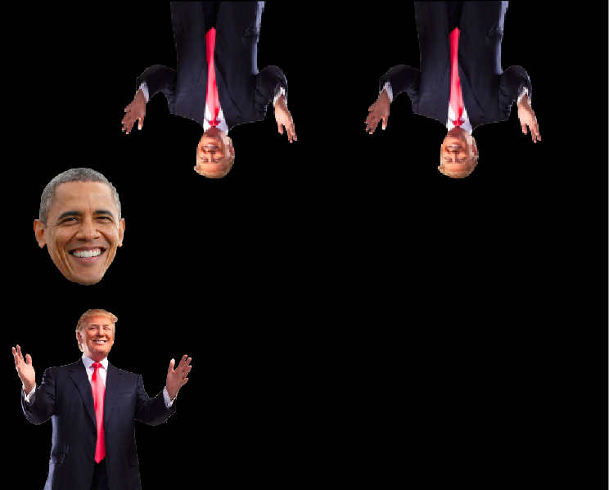
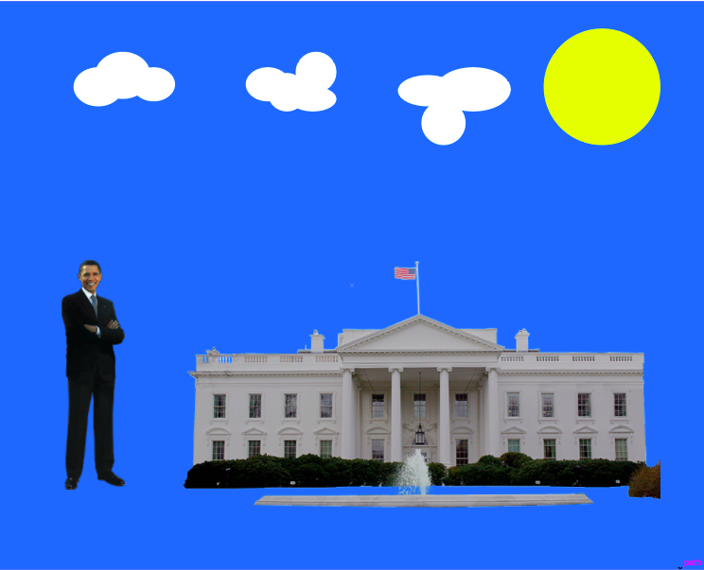
AVATAR
OBSTACLE
GOAL: To move Obama for a certain amount of time without hitting Trump, making him reach the White House.
(3 lives)
INTERACTIVITY: Use spacebar to move Obama up or down.

